Slide 1
Introduction to
Class and Objects
Lecture-5

Slide 2
Object-oriented programming (OOP)
An object-oriented program is structured as community of interacting agents called objects. Each object has a role to play. Each object provides a service or performs an action that is used by other members of the community.
Simula is considered as the first object-oriented programming language. The programming paradigm where everything is represented as an object, is known as truly object-oriented programming language.
Smalltalk is considered as the first truly object-oriented programming language.

Slide 3
Advantage of OOPs
OOPs makes development and maintenance easier where as in Procedure-oriented programming language it is not easy to manage if code grows as project size grows.
OOPs provides data hiding whereas in Procedure-oriented programming language a global data can be accessed from anywhere.
OOPs provides ability to simulate real-world event much more effectively. We can provide the solution of real word problem if we are using the Object-Oriented Programming language.
Provide facility of reusability.

Slide 4
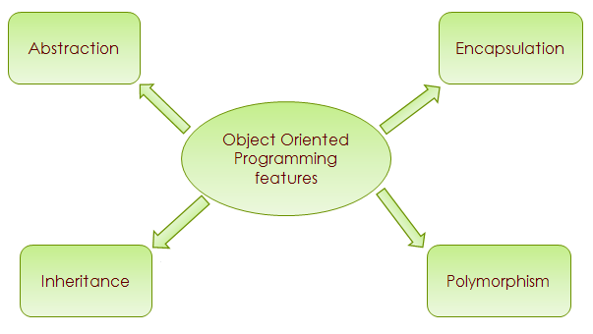
Object Oriented Programming features
Notes:
http://beginnersbook.com/2013/04/oops-concepts/
http://www.c-sharpcorner.com/UploadFile/cda5ba/object-oriented-programming-with-real-world-scenario/

Slide 5

Object Oriented Programming features
Abstraction: Data Abstraction is the property by virtue of which only the essential details are displayed to the user. The trivial or the non-essentials units are not displayed to the user.
Ex: A car is viewed as a car rather than its individual components.
Encapsulation: Encapsulation is defined as the wrapping up of data under a single unit. It is the mechanism that binds together code and the data it manipulates.
Technically in encapsulation, the variables or data of a class is hidden
from any other class and can be accessed only through any member
function of own class in which they are declared.
As in encapsulation, the data in a class is hidden from other classes, so
it is also known as data-hiding.
Encapsulation can be achieved by declaring all the variables in the class
as private and writing public methods in the class to set and get the values
of variables.

Slide 6
Object Oriented Programming features
Polymorphism: Polymorphism refers to the ability of OOPs programming languages to differentiate between entities with the same name efficiently. This is done by Java with the help of the signature and declaration of these entities.
Inheritance: Inheritance is an important pillar of OOP (Object Oriented Programming). It is the mechanism in java by which one class is allow to inherit the features (fields and methods) of another class.
Message passing: A single object by itself may not be very useful. An application contains many objects. One object interacts with another object by invoking methods on that object. It is also referred to as Method Invocation.

Slide 7
Java Classes/Objects
Java is an object-oriented programming language.
Everything in Java is associated with classes and objects, along with its attributes and methods.
For example: in real life, a car is an object. The car has attributes, such as weight and color, and methods, such as drive and brake.
A Class is like an object constructor, or a "blueprint" for creating objects.

Slide 8
What are Objects?
Object means a real word entity such as pen, chair, table etc.
The term "object" usually refers to instance. Objects are instance of a class.
Software objects model real-world objects or abstract concepts
- E.g. dog, bicycle, queue
• Objects have states behaviors
- Dogs' states: name, color, breed, hungry
- Dogs' behaviors: barking, fetching, sleeping

Slide 9
What are Objects? (Cont…)
How do software objects implement real world objects?
- Use variables/data to implement states
- Use methods/functions to implement behaviors.
An object is a software bundle of variables and related method.

Slide 10
What are Objects? (Cont…)
An object has three characteristics:
state: represents data (value) of an object.
behavior: represents the behavior (functionality) of an object such as deposit, withdraw etc.
identity: Object identity is typically implemented via a unique ID. The value of the ID is not visible to the external user. But, it is used internally by the JVM to identify each object uniquely.

Slide 11

What are Objects? (Cont…)
Examples of states and behaviors
Object: House
State: Address, Color, Area
Behavior: Open door, close door
Object: Pen
State: Name is Reynolds, Color is white etc.
Behavior: Used to write

Slide 12
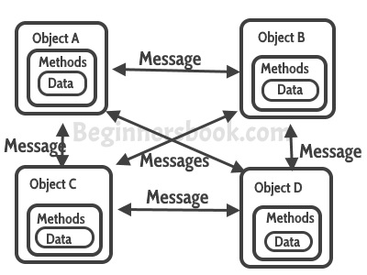
Characteristics of Objects

Slide 13
What is Class?
In Java, a class is a definition of objects of the same kind. In other words, a class is a blueprint, template, or prototype that defines and describes the static attributes and dynamic behaviors common to all objects of the same kind.

Slide 14
What is Class?(Cont..)
Classes provide the structure for objects
- Define their prototype
• Classes define:
- Set of attributes : Also called state. Represented by variables and properties.
- Behavior : Represented by methods
• A class defines the methods and types of data associated with an object

Slide 15
General Form of a Class
class Classname {
type instance-variable1;
type instance-variable2;
// ...
type instance-variableN;
type methodname1(parameter-list) {
// body of method
}
type methodname2(parameter-list) {
// body of method
}
// ...
type methodnameN(parameter-list) {
// body of method
}
}
Notes:
A class is declared by use of the class keyword. The data, or variables, defined within a class are called instance variables. The code is contained within methods. Collectively, the methods and variables defined within a class are called members of the class. Variables defined within a class are called instance variables because each instance of the class (that is, each object of the class) contains its own copy of these variables. Thus, the data for one object is separate and unique from the data for another

Slide 16
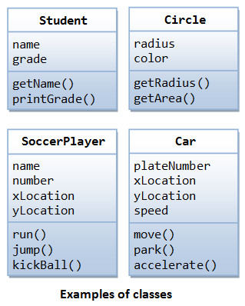
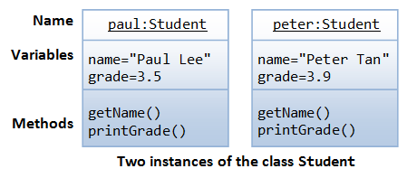
Class and Object
Creating an object from a class is called instantiation

Slide 17
Creating Objects
As mentioned previously, a class provides the blueprints for objects.
So basically, an object is created from a class.
In Java, the new keyword is used to create new objects.
There are three steps when creating an object from a class
Declaration − A variable declaration with a variable name with an object type.
Instantiation − The 'new' keyword is used to create the object.
Initialization − The 'new' keyword is followed by a call to a constructor. This call initializes the new object.

Slide 18
Creating Objects
Obtaining objects of a class is two steps process:
1. Declare a variable of the class type.
2. Acquire an actual, physical copy of the object and assign it to that variable.
To allocate a physical memory new() is used.
It dynamically allocates memory for an object and returns a reference to it.
In Java, all class objects must be dynamically allocated.

Slide 19
Simple Example of Object and Class
class Student {
int id;//data member (also instance variable)
String name;//data member(also instance variable)
}
class StudentTester {
public static void main(String args[]){
Student s1=new Student(); //creating an object of Student
System.out.println(s1.id);
System.out.println(s1.name);
}
}
The new keyword is used to allocate memory at runtime.
Notes:
Output:
0 null
Instance variable in Java
A variable that is created inside the class but outside the method, is known as instance variable.Instance variable doesn't get memory at compile time.It gets memory at runtime when object(instance) is created.That is why, it is known as instance variable.
Method in Java
In java, a method is like function i.e. used to expose behaviour of an object.
Advantage of Method
Code Reusability
Code Optimization
new keyword
The new keyword is used to allocate memory at runtime.

Slide 20
Another Simple Example
class Box
{
double width;
double height;
double depth;
}
class BoxDemo
{
public static void main( String args[])
{
Box mybox, mybox1;
mybox = new Box();
mybox1 = new Box();
mybox.width=10;
mybox.height = 20;
mybox. depth = 15;
mybox1.width = 10;
mybox1.height = 25;
mybox1.depth=5;
}
}

Slide 21
Another Simple Example- Some points
Members are linked to an object using dot (.) operator.
Each object contains its own copy of each instance variables defined by the class.
The java compiler automatically puts each class into it’s own .class file.
- For this example, two .class files:
1. Box.class
2. BoxDemo.class

Slide 22
A Closer Look at New
Box mybox;
mybox = new Box();
Box b1 = new Box();
Box b2 = b1;
null
mybox
Width
Height
mybox
Call to the default constructor defined by the compiler. It initializes the instance variables to 0.
Depth
b1
Width
b2
Height
Depth

Slide 23
Different ways to create an object in Java
By new keyword
By newInstance() method
By clone() method
Annonymous object
multiple objects by one type only
Notes:
Annonymous object : new Calculation().fact(5);
Creating multiple objects by one type only : Rectangle r1=new Rectangle(),r2=new Rectangle();
Class.forName can only call the default constructor, slow than new, need to use when we exactly do not know what type object need to create at compile time.
New is vice versa.

Slide 24
References
Java references are used to point to Java objects created by new
Java objects are always passed by reference to other functions, never by value
A reference variable holds the memory address.
It is similar to the pointer but does not allow pointer arithmetic
Key difference- cannot manipulate as pointer– It point any arbitrary memory location or it cannot be manipulate like an integer.

Slide 25
The null Reference
An object reference variable that does not currently point to an object is called a null reference
The reserved word null can be used to explicitly set a null reference:
name = null;
An object reference variable declared at the class level (an instance variable) is automatically initialized to null
The programmer must carefully ensure that an object reference variable refers to a valid object before it is used

Slide 26
Objects & References
Assignment with References to Objects:
Code: Memory:
Box box1;
Box box2;
box1
box2
box1 = new Box(8, 5, 7);
box1 box2
L=8, W=5, H=7
box2 = box1; // note: two references // but only one object
box1 box2
L=8, W=5, H=7
box1 =
new Box(3, 9, 2);
box1 box2
L=3, W=9, H=2
L=8, W=5, H=7
box1 = box2;
// Old reference lost!
box1 box2
L=3, W=9, H=2
L=8, W=5, H=7

Slide 27
References vs. Pointers
Java is advertised as “having no pointers.”
In reality, Java is mostly pointers!
Every non-primitive datum must be an object.
All objects are dynamic data, accessible via references.
And references are really implicit pointers.
Java does not have explicit pointers:
There exists no way to explicitly manipulate pointers.
There is no explicit dereferencing operator
Restrictions : Java does not allow you to
Cast array or object into integer or vice-versa
Do pointer arithmetic

Slide 28
Life time of an Object
The object exists as long as its reference exists
An object does not exist if there is not reference to it.
Box b = new Box();
b = null; //object now does not exist, it has
// become orphaned object
When an object dies
Local object: when the method goes out of scope.
Static object: declared as a static member of a class. It remain alive as long as the class is loaded.
Instance object: created as a variable within an object class, it dies when the owner object dies.

Slide 29
Methods in Java
In java, a method is like function i.e. used to expose behavior of an object.
A method is always invoked with respect to an object. So, inside a method the object is known and there is no need to specify the object when the instance variables are used.
A method can directly call the method defined in the same class without any object.
The general form of a method:
type name (parameter list)
{
// body of the method
}

Slide 30
Simple Example of Method
class Student{
int rollno;
String name;
void insertRecord(int r, String n){ //method
rollno=r;
name=n;
}
void displayInformation(){//method
System.out.println(rollno+" "+name);
} }
public class StudentTester { public static void main(String args[]){
Student s1=new Student();
Student s2=new Student();
s1.insertRecord(111,"Karan");
s2.insertRecord(222,"Aryan");
s1.displayInformation();
s2.displayInformation();
}
}
s1
s2
rollno=111
name=Karan
rollno=222
name=Aryan

Slide 31
Simple Example of Method
class Box { double width; double height; double depth;
// compute and return volume double volume() { return width * height * depth; }
// sets dimensions of box void setDim(double w, double h, double d) { width = w; height = h; depth = d;
} }
class BoxDemo5 { public static void main(String args[]) { Box mybox1 = new Box(); Box mybox2 = new Box(); double vol;
// initialize each box mybox1.setDim(10, 20, 15); mybox2.setDim(3, 6, 9);
// get volume of first box vol = mybox1.volume(); System.out.println("Volume is " + vol);
// get volume of second box vol = mybox2.volume(); System.out.println("Volume is " + vol); } }

Slide 32
Constructor in Java
Constructor in java is a special type of method that is used to initialize the object.
Java constructor is invoked at the time of object creation. It constructs the values i.e. provides data for the object that is why it is known as constructor.
There are basically two rules defined for the constructor.
Constructor name must be same as its class name
Constructor must have no explicit return type

Slide 33
Types of java constructors
There are two types of constructors:
Default constructor (no-arg constructor) : A constructor that have no parameter is known as default constructor. Default constructor provides the default values to the object like 0, null etc. depending on the type.
<class_name>(){}
Parameterized constructor : A constructor that have parameters is known as parameterized constructor. Parameterized constructor is used to provide different values to the distinct objects.
If there is no constructor in a class, compiler automatically creates a default constructor.

Slide 34
Difference between constructor and method in java
Java Constructor | Java Method
Constructor is used to initialize the state of an object. | Method is used to expose behavior of an object.
Constructor must not have return type. | Method must have return type.
Constructor is invoked implicitly. | Method is invoked explicitly.
The java compiler provides a default constructor if you don't have any constructor. | Method is not provided by compiler in any case.
Constructor name must be same as the class name. | Method name may or may not be same as class name.

Slide 35
Example of default constructor
class Student{
int id;
String name;
void display(){
System.out.println(id+" "+name);
} }
public class StudentTester{
public static void main(String args[]){
Student s1=new Student();
Student s2=new Student();
s1.display();
s2.display();
}
}
Student ( )
{
…id=0;
name =null…
}
Notes:
0 null
0 null
Explanation:In the above class,you are not creating any constructor so compiler provides you a default constructor.Here 0 and null values are provided by default constructor.

Slide 36
Example of parameterized constructor
class Student4{
int id;
String name;
Student4 (int i, String n){
id = i;
name = n;
}
void display(){
System.out.println(id+" "+name);
} }
public class StudentTester{
public static void main(String args[]){
Student4 s1 = new Student4(111,"Karan");
Student4 s2 = new Student4(222,"Aryan");
s1.display();
s2.display();
}
}

Slide 37
Simple Example of Object, Class and Constructors
For example, here we have a class Website that has two data members (also known as fields, instance variables and object states).
This is just a blueprint, it does not represent any website, however using this we can create Website objects (or instances) that represents the websites.
We have created two objects, while creating objects we provided separate properties to the objects using constructor.

Slide 38
Another Simple Example of Object, Class and Constructors
public class Website {
//fields (or instance variable)
String webName;
int webAge;
// constructor
Website(String name, int age){
webName = name;
webAge = age;
}
public static void main(String args[]){
//Creating objects
Website obj1 = new Website("beginnersbook", 5);
Website obj2 = new Website("google", 18);
//Accessing object data through reference
System.out.println(obj1.webName+" "+obj1.webAge);
System.out.println(obj2.webName+" "+obj2.webAge);
}
}

Slide 39
Types of Variables
A class can contain any of the following variable types.
Local variables − Variables defined inside methods, constructors or blocks are called local variables. The variable will be declared and initialized within the method and the variable will be destroyed when the method has completed.
Instance variables − Instance variables are variables within a class but outside any method. These variables are initialized when the class is instantiated. Instance variables can be accessed from inside any method, constructor or blocks of that particular class.
Class variables − Class variables are variables declared within a class, outside any method, with the static keyword.

Slide 40
Local Variables
Local variables are declared in methods, constructors, or blocks.
Local variables are created when the method, constructor or block is entered and the variable will be destroyed once it exits the method, constructor, or block.
Access modifiers cannot be used for local variables.
Local variables are visible only within the declared method, constructor, or block.
Local variables are implemented at stack level internally.
There is no default value for local variables, so local variables should be declared and an initial value should be assigned before the first use..

Slide 41
Local Variables
public class Test {
public void pupAge() {
int age=0;
age = age + 7;
System.out.println("Puppy age is : " + age);
}
public static void main(String args[]) {
Test test = new Test();
test.pupAge();
}
}

Slide 42
Instance Variables
Instance variables are declared in a class, but outside a method, constructor or any block.
Instance variables are created when an object is created with the use of the keyword 'new' and destroyed when the object is destroyed.
Access modifiers can be given for instance variables.
The instance variables are visible for all methods, constructors and block in the class. Normally, it is recommended to make these variables private (access level).
Instance variables have default values. For numbers, the default value is 0, for Booleans it is false, and for object references it is null. Values can be assigned during the declaration or within the constructor.

Slide 43
Instance Variables
public class Employee {
// this instance variable is visible for any child class.
public String name;
// salary variable is visible in Employee class only.
private double salary;
// The name variable is assigned in the constructor.
public Employee (String empName) { name = empName; }
// The salary variable is assigned a value.
public void setSalary(double empSal) { salary = empSal; }
// This method prints the employee details.
public void printEmp() {
System.out.println("name : " + name ); System.out.println("salary :" + salary);
}
public static void main(String args[]) {
Employee empOne = new Employee("Ransika"); empOne.setSalary(1000); empOne.printEmp();
}
}

Slide 44
Class/Static Variables
Class variables also known as static variables are declared with the static keyword in a class, but outside a method, constructor or a block.
There would only be one copy of each class variable per class, regardless of how many objects are created from it.
Static variables are rarely used other than being declared as constants. Constants are variables that are declared as public/private, final, and static. Constant variables never change from their initial value.
Static variables are created when the program starts and destroyed when the program stops.

Slide 45
Class/Static Variables
Visibility is similar to instance variables. However, most static variables are declared public since they must be available for users of the class.
Default values are same as instance variables. For numbers, the default value is 0; for Booleans, it is false; and for object references, it is null. Values can be assigned during the declaration or within the constructor. Additionally, values can be assigned in special static initializer blocks.
Static variables can be accessed by calling with the class name ClassName.variableName.
When declaring class variables as public static final, then variable names (constants) are all in upper case. If the static variables are not public and final, the naming syntax is the same as instance and local variables.

Slide 46
Class/Static Variables
public class Employee {
// salary variable is a private static variable
private static double salary;
// DEPARTMENT is a constant
public static final String DEPT= "Development ";
public static void main(String args[]) {
salary = 1000;
System.out.println(DEPT+"average salary:"+salary);
}
}

Slide 47
Method Overloading in Java
If a class have multiple methods by same name but different parameters, it is known as Method Overloading.
Method overloading increases the readability of the program.
In java, Method Overloading is not possible by changing the return type of the method.
There are two ways to overload the method in java - By changing number of arguments
- By changing the data type

Slide 48
Example-1 of Method Overloading
class Calculation{
void sum(int a,int b){
System.out.println(a+b);
}
void sum(int a,int b,int c){
System.out.println(a+b+c);
}
public static void main(String args[]){
Calculation obj=new Calculation();
obj.sum(10,10,10);
obj.sum(20,20);
}
}

Slide 49
Example-2 of Method Overloading
class Calculation2{
void sum(int a,int b){
System.out.println(a+b);
}
void sum(double a,double b){
System.out.println(a+b);
}
public static void main(String args[]){
Calculation2 obj=new Calculation2();
obj.sum(10.5,10.5);
obj.sum(20,20);
}
}

Slide 50
Constructor Overloading
class Student5{
int id;
String name;
int age;
Student5(int i,String n){
id = i;
name = n;
}
Student5(int i,String n,int a){
id = i;
name = n;
age=a;
}
void display(){System.out.println(id+" "+name+" "+age);}
public static void main(String args[]){
Student5 s1 = new Student5(111,"Karan");
Student5 s2 = new Student5(222,"Aryan",25);
s1.display();
s2.display();
}
}

Slide 51
Multiple Classes in Java
class Computer {
Computer() {
System.out.println("Constructor of Computer class.");
}
void computer_method() {
System.out.println("Power gone! Shut down your PC soon...");
}
public static void main(String[] args) {
Computer my = new Computer();
Laptop your = new Laptop();
my.computer_method();
your.laptop_method();
}
}
class Laptop {
Laptop() {
System.out.println("Constructor of Laptop class.");
}
void laptop_method() {
System.out.println("99% Battery available.");
}
}

Slide 52
Java Package
A java package is a group of similar types of classes, interfaces and sub-packages.
Package in java can be categorized in two form, built-in package and user-defined package.
There are many built-in packages such as java, lang, awt, javax, swing, net, io, util, sql etc.
Subpackage in java : Package inside the package is called the subpackage. It should be created to categorize the package further.

Slide 53
Advantage of Java Package
Java package is used to categorize the classes and interfaces so that they can be easily maintained.
Java package provides access protection.
Java package removes naming collision.

Slide 54
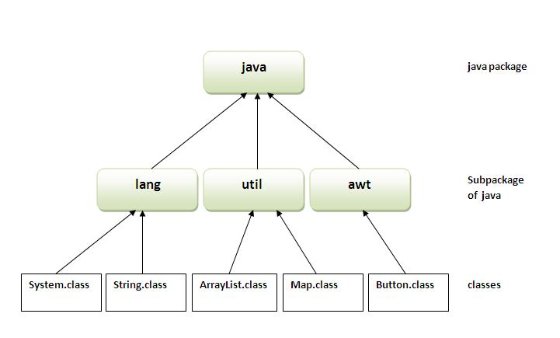
Java Package

Slide 55
Import Statement
A java package is a collection of related classes.
In order to access the available classes in the package, the program must specify the complete dot seperated package path.
The general format:
import package-level1.[package-level2.]classname|*
Two form of import statement:
1. import package.class;
2. import package.*;
Example:
import java.util.Scanner;
import java.util.*;

Slide 56

Example
import java.util.Random;
class random
{
public static void main(String args[])
{
Random r = new Random();
int i;
float v;
for(i=0;i<5;i++)
{
v=r.nextFloat();
System.out.println(v);
}
}
}
Output:
java.lang in automatically imported with every java program.
System.out.println() belongs to java.lang.

Slide 57
Simple example of java package
//save as Simple.java
package mypack;
public class Simple{
public static void main(String args[]){
System.out.println("Welcome to package");
}
}
The package keyword is used to create a package in java.

Slide 58
How to access package from another package?
There are three ways to access the package from outside the package.
import package.*;
import package.classname;
fully qualified name.

Slide 59
Using packagename.*
//save by A.java
package pack;
public class A{
public void msg(){
System.out.println("Hello");
}
}
//save by B.java
package mypack;
import pack.*;
class B{
public static void main(String args[]){
A obj = new A();
obj.msg();
}
}
Notes:
If you use package.* then all the classes and interfaces of this package will be accessible but not subpackages.The import keyword is used to make the classes and interface of another package accessible to the current package.

Slide 60
Using packagename.classname
//save by A.java
package pack;
public class A{
public void msg(){System.out.println("Hello");}
}
//save by B.java
package mypack;
import pack.A;
class B{
public static void main(String args[]){
A obj = new A();
obj.msg();
}
}
Notes:
If you import package.classname then only declared class of this package will be accessible.

Slide 61
Using fully qualified name
//save by A.java
package pack;
public class A{
public void msg(){System.out.println("Hello");}
}
//save by B.java
package mypack;
class B{
public static void main(String args[]){
pack.A obj = new pack.A();//using fully qualified name
obj.msg();
}
}
Notes:
If you use fully qualified name then only declared class of this package will be accessible. Now there is no need to import. But you need to use fully qualified name every time when you are accessing the class or interface.
It is generally used when two packages have same class name e.g. java.util and java.sql packages contain Date class.

Slide 62
Member access modifiers
There are two types of modifiers in java: access modifiers and non-access modifiers.
The access modifiers in java specifies accessibility (scope) of a data member, method, constructor or class.
There are 4 types of java access modifiers:
private: Visible to the class only
default (package): Visible to the package, the default.
No modifiers are needed.
protected: Visible to the package and all subclasses
public: Visible to the world
There are many non-access modifiers such as static, abstract, synchronized, native, volatile, transient etc.

Slide 63
Member access modifiers : public
A class, method, constructor, interface etc declared public can be accessed from any other class.
Therefore fields, methods, blocks declared inside a public class can be accessed from any class belonging to the Java Universe.
However, if the public class we are trying to access is in a different package, then the public class still needs to be imported.
Because of class inheritance, all public methods and variables of a class are inherited by its subclasses.

Slide 64
Member access modifiers : public
//save by A.java
package pack;
public class A{
public void msg()
{
System.out.println("Hello");
}
}
//save by B.java
package mypack;
import pack.*;
class B{
public static void main(String args[]){
A obj = new A();
obj.msg();
}
}

Slide 65
Member access modifiers : private
Methods, Variables and Constructors that are declared private can only be accessed within the declared class itself.
Private access modifier is the most restrictive access level. Class and interfaces cannot be private.
Variables that are declared private can be accessed outside the class if public getter methods are present in the class.
Using the private modifier is the main way that an object encapsulates itself and hide data from the outside world.

Slide 66
Member access modifiers : private (..)
class A{
private int data=40;
private void msg(){System.out.println("Hello java");}
}
public class Simple{
public static void main(String args[]){
A obj=new A();
System.out.println(obj.data); //Compile Time Error
obj.msg();//Compile Time Error
}
}

Slide 67
Member access modifiers : protected
The protected access modifier is accessible within package and outside the package but through inheritance only.
Variables, methods and constructors which are declared protected in a superclass can be accessed only by the subclasses in other package or any class within the package of the protected members' class.
The protected access modifier cannot be applied to class and interfaces.
Methods, fields can be declared protected, however methods and fields in a interface cannot be declared protected.

Slide 68
Member access modifiers : protected(…)
//save by A.java
public class A{
protected void msg()
{
System.out.println("Hello");
} }
//save by B.java
class B extends A{
public static void main(String args[]){
B obj = new B();
obj.msg();
}
}

Slide 69
Member access modifiers : default
The default Java access modifier is declared by not writing any access modifier at all.
The default access modifier means that code inside the class itself as well as code inside classes in the same package as this class, can access the class, field, constructor or method which the default access modifier is assigned to.
Therefore, the default access modifier is also sometimes referred to as the package access modifier.
The fields in an interface are implicitly public static final and the methods in an interface are by default public.

Slide 70
Member access modifiers : default (..)
//save by A.java
package pack;
class A{
void msg(){
System.out.println("Hello");
}
}
//save by B.java
package mypack;
import pack.*;
class B{
public static void main(String args[])
{
A obj = new A();
//Compile Time Error
obj.msg();
//Compile Time Error
}
}

Slide 71
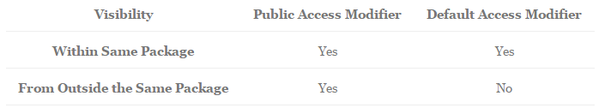
Java Access Modifiers Table for Class

Slide 72
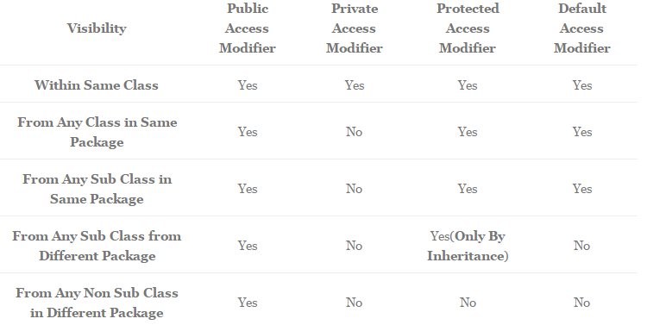
Java Access Modifiers Table for Variables

Slide 73
Java Non Access Modifiers
Java provides a number of non-access modifiers to achieve many other functionalities.
The static modifier for creating class methods and variables.
The final modifier for finalizing the implementations of classes, methods, and variables.
The abstract modifier for creating abstract classes and methods.
The synchronized and volatile modifiers, which are used for threads.

Slide 74
Java static keyword
The static keyword in java is used for memory management mainly.
The static can be:
variable (also known as class variable)
method (also known as class method)
block
nested class

Slide 75
Java static variable
The static keyword is used to create variables that will exist independently of any instances created for the class.
Only one copy of the static variable exists regardless of the number of instances of the class.
Static variables are also known as class variables. It saves memory.
Local variables cannot be declared static.
//Program of static variable
class Student8{
int rollno;
String name;
static String college ="ITS";
Student8(int r,String n)
{
rollno = r;
name = n;
}
void display (){
System.out.println (rollno+" "+name+" "+college);
}
public static void main(String args[])
{
Student8 s1 = new Student8(111,"Karan");
Student8 s2 = new Student8(222,"Aryan");
s1.display();
s2.display();
}
}

Slide 76
Java static method
A static method can be invoked without the need for creating an instance of a class.
static method can access static data member and can change the value of it.
class Student{
int rollno;
String name;
static String college = "ITS";
static void change(){
college = "BBDIT";
}
Student(int r, String n){
rollno = r;
name = n;
}
void display (){
System.out.println(rollno+" "+name+" "+college);
}
public static void main(String args[]){
Student.change();
Student s1 = new Student (111,"Karan");
Student s2 = new Student (222,"Aryan");
Student s3 = new Student (333,"Sonoo");
s1.display();
s2.display();
s3.display();
}
}

Slide 77
Final in Java
Final Variables
A final variable can be explicitly initialized only once.
A reference variable declared final can never be reassigned to refer to an different object.
However, the data within the object can be changed. So, the state of the object can be changed but not the reference.
With variables, the final modifier often is used with static to make the constant a class variable.

Slide 78
Final in Java
Final Methods
A final method cannot be overridden by any subclasses.
As mentioned previously, the final modifier prevents a method from being modified in a subclass.
The main intention of making a method final would be that the content of the method should not be changed by any outsider.
Final Classes
The main purpose of using a class being declared as final is to prevent the class from being subclassed. Doing this can confer security and efficiency benefits, so many of the Java standard library classes are final, such as java.lang.System and java.lang.String.
If a class is marked as final then no class can inherit any feature from the final class.

Slide 79
Accessor Methods
An accessor method is used to return the value of a private field. It follows a naming scheme prefixing the word "get" to the start of the method name
public class Person {
//Private fields
private String firstName;
private String middleNames;
private String lastName;
private String address;
private String username;
//Constructor method
public Person(String firstName, String middleNames, String lastName, String address)
{
this.firstName = firstName;
this.middleNames = middleNames;
this.lastName = lastName;
this.address = address;
this.username = "";
} }

Slide 80
Accessor Methods (…)
//Accessor for firstName
public String getFirstName()
{
return firstName;
}
//Accessor for middleNames
public String getMiddlesNames()
{
return middleNames;
}
//Accessor for lastName
public String getLastName()
{
return lastName;
}
public class PersonExample
{
public static void main(String[] args)
{
Person dave = new Person("Dave", "Bob Bill", "Davidson", "12 Pall Mall"); System.out.println(dave.getFirstName() + " " + dave.getMiddlesNames() + " " + dave.getLastName());
}
}

Slide 81
Mutator Methods
A mutator method is used to set a value of a private field. It follows a naming scheme prefixing the word "set" to the start of the method name.
//Mutator for address
public void setAddress(String address)
{
this.address = address;
}
//Mutator for username
public void setUsername(String username)
{
this.username = username;
}

Slide 82
Mutator Methods (…)
public class PersonExample
{
public static void main(String[] args)
{
Person dave = new Person("Dave", "Bob Bill", "Davidson", "12 Pall Mall");
dave.setAddress("256 Bow Street");
dave.setUsername("DDavidson");
}
}

Slide 83
The this Keyword
The this keyword can be used inside any method to refer to the current object.
Box(double w, double h, double d) {
this.width = w;
this.height = h;
this.depth = d;
}
Instance Variable Hiding : when a local variable has the same name as an instance variable, the local variable hides the instance variable.
Box(double width, double height, double depth) {
this.width = width;
this.height = height;
this.depth = depth;
}

Slide 84
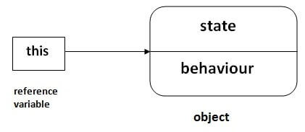
The this Keyword
There can be a lot of usage of java this keyword. In java, this is a reference variable that refers to the current object.

Slide 85
Usages of this keyword
this can be used to refer current class instance variable.
this can be used to invoke current class method (implicitly)
this() can be used to invoke current class constructor.
this can be passed as an argument in the method call.
this can be passed as argument in the constructor call.
this can be used to return the current class instance from the method.

Slide 86
Refer current class instance variable
class Student{
int rollno;
String name;
float fee;
Student(int rollno,String name,float fee){
rollno=rollno;
name=name;
fee=fee;
}
void display(){System.out.println(rollno+" "+name+" "+fee);}
}
class TestThis1{
public static void main(String args[]){
Student s1=new Student(111,"ankit",5000f);
Student s2=new Student(112,"sumit",6000f);
s1.display();
s2.display();
}
}

Slide 87
Refer current class instance variable
class Student{
int rollno;
String name;
float fee;
Student(int rollno,String name,float fee){
this.rollno=rollno;
this.name=name;
this.fee=fee;
}
void display(){System.out.println(rollno+" "+name+" "+fee);}
}
class TestThis1{
public static void main(String args[]){
Student s1=new Student(111,"ankit",5000f);
Student s2=new Student(112,"sumit",6000f);
s1.display();
s2.display();
}
}

Slide 88
Invoke current class constructor
The this() constructor call can be used to invoke the current class constructor.
It is used to reuse the constructor. In other words, it is used for constructor chaining.
class A{
A(){System.out.println("hello a");}
A(int x){
this();
System.out.println(x);
}
}
class TestThis5{
public static void main(String args[]){
A a=new A(10);
}
}

Slide 89
Predefined Stream
Stream:
-A stream is an abstraction that either produces or consumes information.
-It is linked to a physical device by a java I/O system.
-They hide the details of the physical device to which they are connected.
System:
-System is a predefined class included in the package java.lang. (Imported automatically by all java programs).
-It includes three predefined stream variables:
1. in 2. out. 3. err

Slide 90
The Predefined Streams
System.out: refers to the standard output stream. It is an object of type PrintStream.
System.in: refers to the standard input stream. It is an object of type InputStream.
System.err: refers to the standard error stream. It is an object of type PrintStream.
Note: they are defined as public and static.
InputStream:
This class in included in the package java.io.
It has some subclasses the handle the differences between various devices.
Includes some methods that the subclasses will implement.

Slide 91
Garbage Collection
In java, garbage means unreferenced objects.
Garbage Collection is process of reclaiming the runtime unused memory automatically. In other words, it is a way to destroy the unused objects.
To do so, we were using free() function in C language and delete() in C++. But, in java it is performed automatically. So, java provides better memory management.
Advantages:
It makes java memory efficient because garbage collector removes the unreferenced objects from heap memory.
It is automatically done by the garbage collector(a part of JVM) so we don't need to make extra efforts.

Slide 92
gc() method
The gc() method is used to invoke the garbage collector to perform cleanup processing. The gc() is found in System and Runtime classes.
public static void gc(){}
Garbage collection is performed by a daemon thread called Garbage Collector(GC). This thread calls the finalize() method before object is garbage collected.

Slide 93
The finalize( ) Method
The finalize() method is invoked each time before the object is garbage collected. This method can be used to perform cleanup processing. This method is defined in Object class as:
protected void finalize(){}
The Garbage collector of JVM collects only those objects that are created by new keyword. So if you have created any object without new, you can use finalize method to perform cleanup processing (destroying remaining objects).
Notes:
Sometimes an object will need to perform some action when it is destroyed. For example, if an object is holding some non-Java resource such as a file handle or character font, then you might want to make sure these resources are freed before an object is destroyed. To handle such situations, Java provides a mechanism called finalization. By using finalization, you can define specific actions that will occur when an object is just about to be reclaimed by the garbage collector.

Slide 94
Simple Example of garbage collection in java
public class TestGarbage1{
public void finalize(){System.out.println("object is garbage collected");}
public static void main(String args[]){
TestGarbage1 s1=new TestGarbage1();
TestGarbage1 s2=new TestGarbage1();
s1=null;
s2=null;
System.gc();
}
}

Slide 95
Reading Materials
Java The Complete Reference
Author : Herbert Schildt
Chapter 6 of your text book
Web Source:
http://docs.oracle.com/javase/tutorial/
http://www.tutorialspoint.com/java/
http://www.javatpoint.com/java-tutorial/
https://www.geeksforgeeks.org/java/

